Slide 1
Empirical Methods in Finance - Exercise 2 week 1
WG 08 - Subgroup 2
Furia Edoardo, Kiks Stan, Kim Jinhyun

Slide 2

Data
Source
WRDS (WHARTON RESEARCH DATA SERVICE)
WRDS is a platform with aggregated and standardized financial data e.g. company financials & accounting, data on boards & directors, and market data. These are linked from different databases, such as BoardEx, Compustat (Global and North America) and CSMAR.
Selected Database
Compustat Execucomp
To restrict the compensation data to CEO only, we have used Execucomp database from Compustat. Since Execucomp provides only CEO compensation data, we considered the sample to be only about CEO.
‘Compustat’ provides standardized North American and global financial statement and market data for over 80,000 active and inactive publicly traded companies that financial professionals have relied on for over 50 years
‘Execucomp’ is Executive compensation data collected directly from each company’s annual proxy
Selected variables
Total Compensation ($) (TDC1), Executive ID number (EXECID), Value of Option Awards ($) (OPTION_AWARDS), Value of Stock awards ($) (STOCK_AWARDS), Bonus ($), Salary ($)

Slide 3
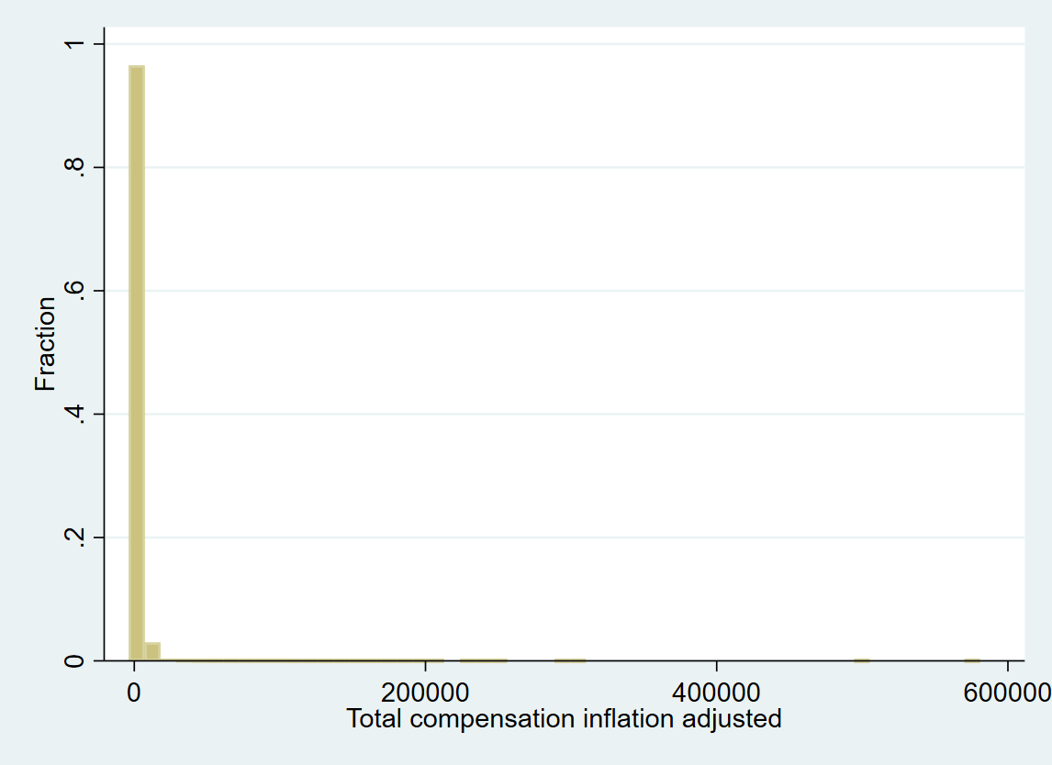
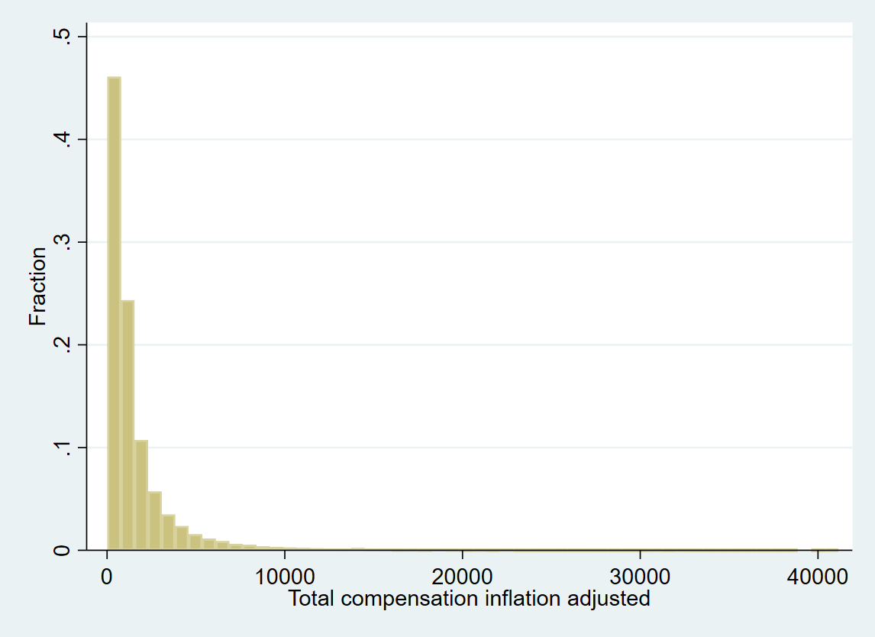
Histogram of total compensation
First we adjusted for inflation by: gen TDC1_adinf=TDC1/CPI_norm
Second, winsorized by year: winsorizeJ TDC1_adinf, suffix(_win) by(YEAR) cuts(0.5 99.5)
Third, plot two histograms:

Slide 4
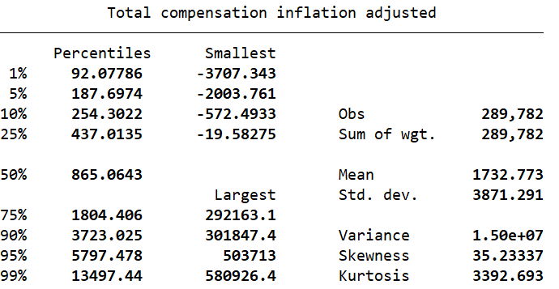
Outliers total compensation
Before winsorization there are some large outliers.
After winsorization, outliers slightly reduced but still large outliers. Might need to winsorize at larger percentile on the right hand side.
Left side outliers are negative, likely to be incorrect entries (negative compensation highly unlikely).
Right side outliers not clear, could be a exceptionally highly CEO. Compensation of 580 million is possible, especially in case of large stock and option awards

Slide 5
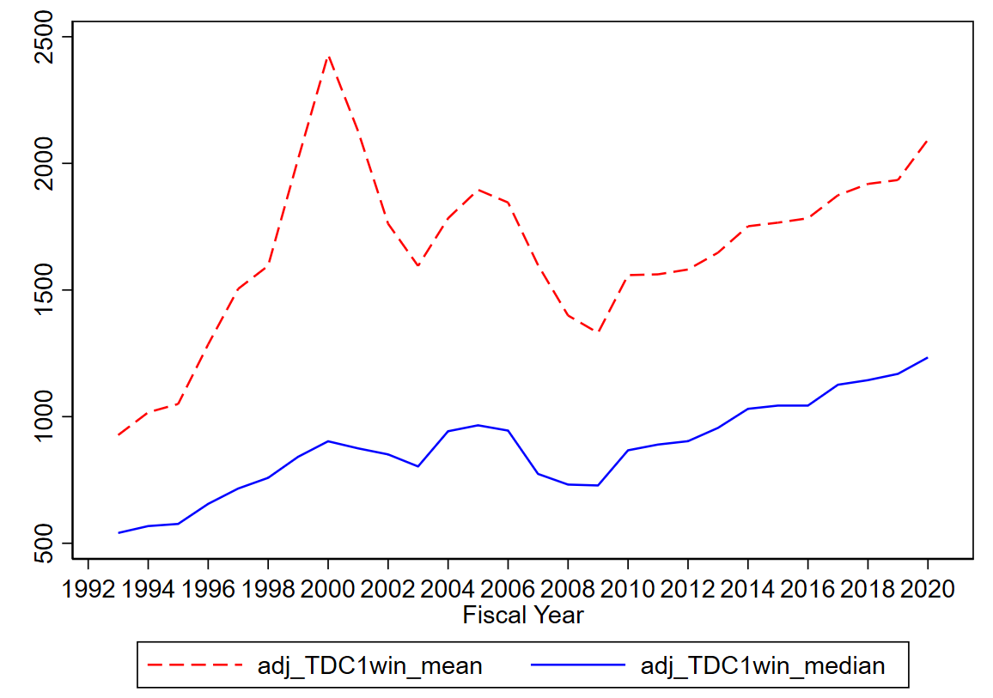
Evolution of the CEOs’ total compensation over time: Mean and Median by year
Mean and median (expressed in thousands of US dollars) show similar patterns, with an overall increase from 1992 to 2020, consistent with the rising inequality in the american society with regard to compensations and wealth
Mean clearly pulled up by extreme values, median more conservative proxy for the evolution of the total compensation of CEOs
Exception in trends for mean and median: during the late ‘90s (years of the Dot-com bubble), the mean grew in a more pronounced way, probably due to very high values for the most paid CEOs

Slide 6
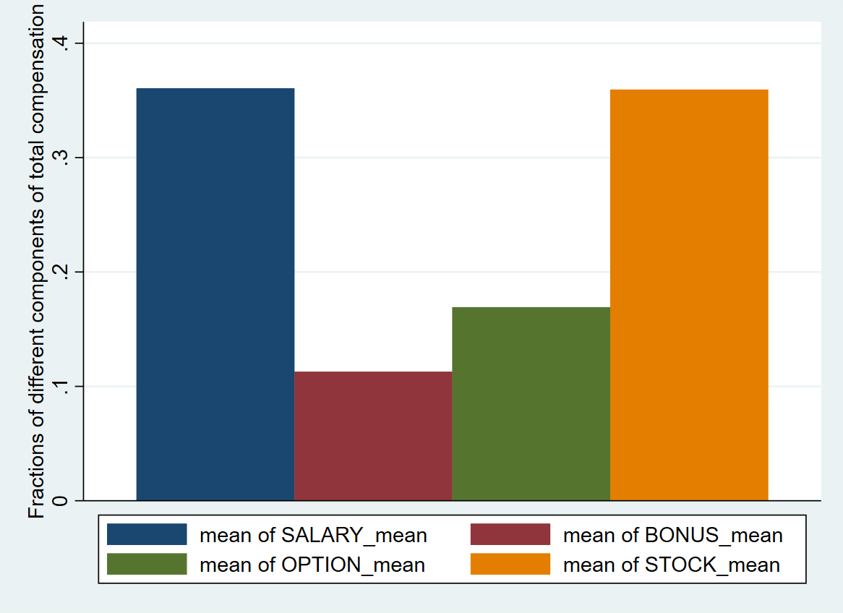
Different components of total CEOs’ compensation : means for period 1993-2020
Overall, in the period considered (1993-2020), salary (0.361%) and stock compensation (0.359%) are, on average, the largest components of the total CEOs’ compensations
However, data on stock and option awards are only available for the time period 2006-2020, while data on salary and bonus are available for the entire time period 1993-2020
The reason for this lack of data before 2006 is due to a change in the accounting rules for companies which took place in 2006: FAS 123R. This new accounting standard implied that the costs associated with equity payment for employees have to be expensed on financial statements

Slide 7
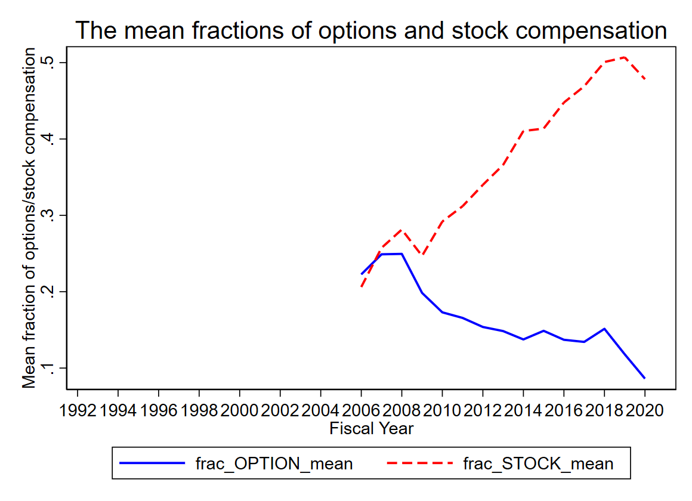
Evolution of stock and option compensation over time: means by year
As we can see from the graph on the left,, the proportion of stock compensation and that of option payments have an opposite trend
The stock compensation fraction for the CEO has been increasing over time; the option compensation method has a downward trend
What are the reasons for this shift from stock options to stocks in the CEOs’ compensations in the recent years?

Slide 8
Evolution of stock and option compensation over time: Reasons for the shift from options to stocks
The first and most obvious reason for the change in the equity incentive awards for CEOs is the FAS 123R (2006), already mentioned before. Due to this new accounting standard, stock options started to be regarded as expenses to be reported by the companies granting them to their executives, thus lowering the incentive of options
Another reason can be the drop in the stock market in 2008, which made executives clearly more reluctant to accept options compensation, since, in case of negative returns, stock options have no value for them. This consideration might have caused the declining trend with regard to options in the years following the Great Recession
However, stock options may represent a better incentive for executives rather than stocks when the company and its stock price are expected to grow remarkably in the following years : in that case, the gain that executives will have from stock options will be larger than that from stocks; otherwise, they are more likely to prefer stocks over stock options

Slide 9
References
https://www.investopedia.com/articles/06/fas123r.asp
https://corpgov.law.harvard.edu/2014/10/02/what-has-happened-to-stock-options/
Data link: https://drive.google.com/file/d/1kWO9qqACkPNK3xCUw3xVZeR-8o0D_0xP/view?usp=sharing

